Slide 1

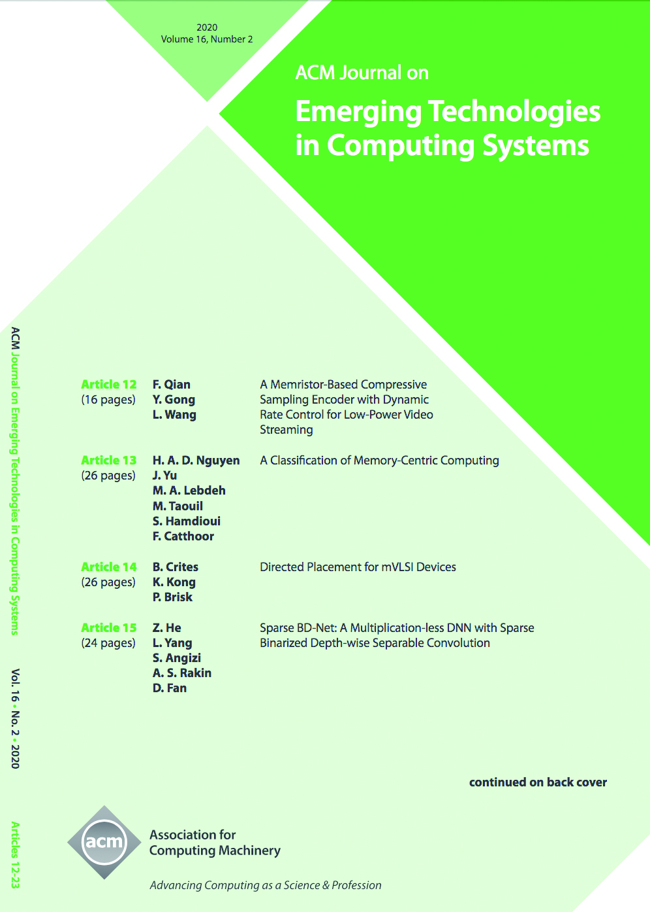

ACM Journal on Emerging Technologies in Computing Systems (JETC)
Editor-in-Chief
Ramesh Karri
Polytechnic Institute of New York University (USA)
Major economic and technical challenges are expected to impede the continued scaling of semiconductor devices. This has resulted in the search for alternate mechanical, biological/biochemical, nanoscale electronic, asynchronous and quantum computing, and sensor technologies. As the underlying nanotechnologies continue to evolve in the labs of chemists, physicists, and biologists, it has become imperative for computer scientists and engineers to translate the potential of the basic building blocks (analogous to the transistor) emerging from these labs into information systems. The journal provides comprehensive coverage of innovative work in the specification, design analysis, simulation, verification, testing, and evaluation of computing systems constructed out of emerging technologies and advanced semiconductors. Topics include, but are not limited to Logic Primitive Design and Synthesis, System-Level Specification, Design and Synthesis, Software-Level Specification, Design and Synthesis, and Mixed-Technology Systems.
https://jetc.acm.org

